Slide 1
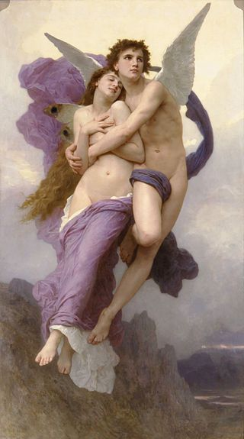
Cupid and Psyche
Group1
N1042420 財金三甲 謝人傑
10541065 會資二乙 陳霈珈
10541072 會資二乙 林欣儀
10541073 會資二乙 江恣妤
10541078 會資二乙 方映晴

Slide 2
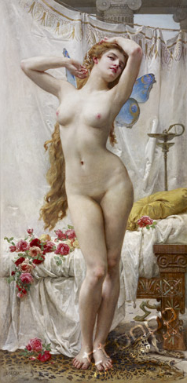
There was once a king who had three daughters.
The youngest,Psyche,excelled her sisters so greatly that beside them she seemed a very goddess consorting with mere mortals.

Slide 3
They would even say that Venus herself could not equal this mortal.
As they thronged in ever-growing numbers to worship her loveliness no one any more gave a thought to Venus herself.

Slide 4
It may well be believed that the goddess would not put up with this treatment.
As always when she was in trouble she turned for help to her son,that beautiful winged youth whom some call Cupid and others Love.
“Use your power.”she said, “and make the hussy fall madly in love with the vilest and most despicable creature there is in the whole world.”

Slide 5
Her farther traveled to an orcale of Apollo to ask his advice.
Apollo said that Psyche,dressed in deepest mourning,must be set on the summit of a rocky hill and left alone,and that there her destined husband,a fearful winged serpent,would come to her and make her his wife.

Slide 6
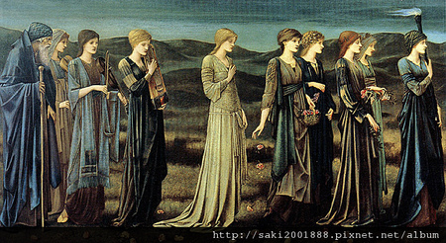
They dressed the maiden as though for her death and carried her to the hill with greater sorrowing than if it had been to her tomb.

Slide 7
But Psyche herself kept her courage, “You should have wept for me before,”she told them, “because of the beauty that has drawn down upon me the jealousy of Heaven.Now go,knowing that I am glad the end has come.”

Slide 8
On the high hilltop in the darkness Psyche sat, waiting for she knew not what terror.
When she wept and trembled, a soft breath of air came through the stillness to her, the gentle breathing of Zephyr, sweetest and mildest of winds.

Slide 9
Floating away from the rocky hill and down until lay upon a grassy meadow soft as a bed and fragrant with flowers. It was so peaceful there, all her trouble left her and she slept.
Woke beside a river, on its bank was a mansion stately and beautiful as though build for a god.

Slide 10
No sound was to be heard; the place seemed deserted and Psyche drew near, awestruck at the sight of such splendor.
As she hesitated on the threshold, voices sounded in her ear. She could see no one, but the words they spoke came clearly to her. The house was for her.

Slide 11
While she dined, sweet music breathed around her: a great choir seemed to sing to a harp, but she could only hear, not see, them.
Throughout the day, except for the strange companionship of the voices, she was alone, but in some inexplicable way she felt sure that with the coming of the night her husband would be with her.

Slide 12
When she felt him beside her and heard his voice softly murmuring in her ear, all her fears left her.
She knew without seeing him that here was no monster or shape of terror, but the lover and husband she had longed and waited for.

Slide 13
One night, however, her dear though unseen husband warned her that danger in the shape of her two sisters was approaching.
“They are coming to the hill where you disappeared, to weep for you”
“But you must not let them see you or you will bring great sorrow upon me and ruin to yourself.”

Slide 14
“Do what you will.”
“But you are seeking your own destruction.”
Then he warned her solemnly not to be persuaded by anyone to try to see him, on pain of being separated from him forever.

Slide 15
The next morning the two came, brought down from the mountain by Zephyr.
Happy and excited, Psyche was waiting for them.
It was long before the three could speak to each other.

Slide 16
When they entered the palace, the elder sisters saw its surpassing treasures.
When they sat at the banquet and heard the music, bitter envy took possession of them and a devouring curiosity as to who was their sister’s husband.

Slide 17
Then filling their hands with gold and jewels, she had Zephyr bear them back to the hill.
They went willingly enough, but their hearts were on fire with jealousy.
All their own wealth and good fortune seemed to them as nothing compared with Psyche’s and their envious anger to worked in them that they came finally to plotting how to ruin her.

Slide 18
That very night Psyche,s husband warned her once more. She would not listen when he begged her not to let them come again. He yielded as before, and very soon the two wicked women arrived.
They had knew for a fact, that her husband was not a man. He was kind now, no doubt, but he would certainly turn upon her some night and devour her.

Slide 19
Psyche, aghast, felt terror flooding her heart instead of love. She had wondered so often why he would never let her see him.
They had their advice all prepared beforehand. That night she must hide a sharp knife and a lamp near her bed. When her husband was fast asleep she must leave the bed, light the lamp, and get the knife.

Slide 20
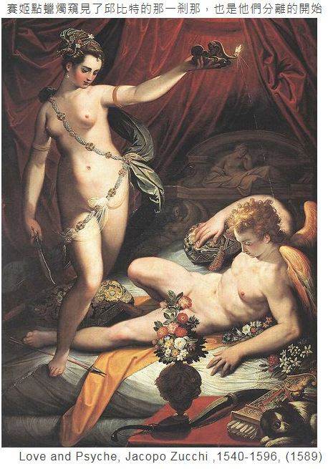
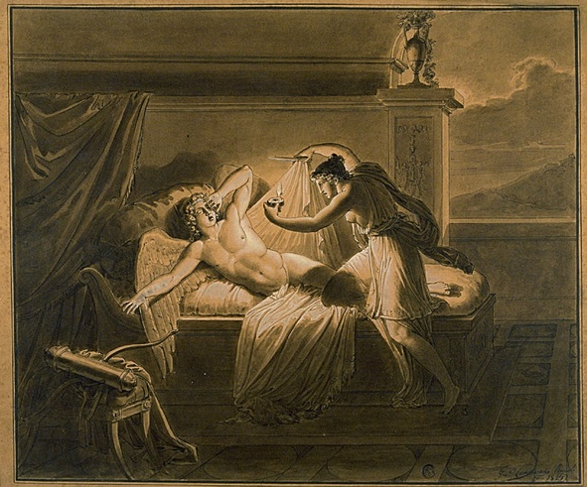
She would see him.

Slide 21
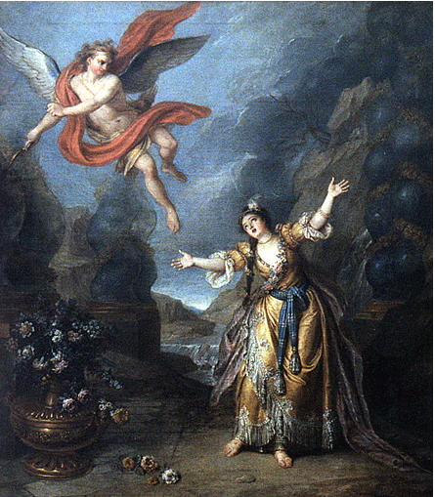
Love cannot live where there is no trust.

Slide 22
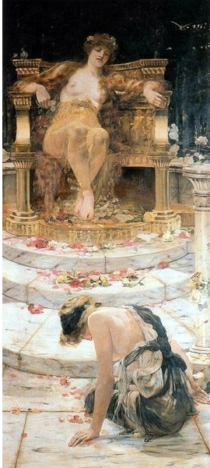
Cupid had gone to his mother's chamber to have his wound cared for, but when Venus heard his story, she was angry and more jealous.
Psyche went to Venus's temple in order to get Cupid and Venus forgiveness.
However,Venus gave her three difficult mission.

Slide 23
With that Venus took a great quantity of the smallest of the seeds, wheat and poppy and millet and so on, and mixed them all together in a heap.
"By nightfall these must all be sorted," she said.
"See to it for your own sake.“

Slide 24
Psyche’s mind was all in a maze because of the cruelty of the command.
But at this moment,the little ants came to help her.
They cried to each other, "Come, have mercy on this poor maid and help her diligently."

Slide 25
The next morning Venus devised another task for Psyche, this time a dangerous one.
"Down there near the riverbank," she said, "where the bushes grow thick, are sheep with fleeces of gold. Go fetch me some of their shining wool.“
The sheep were indeed very fierce, but if Psyche would wait until they came out of the bushes toward evening to rest beside the river, she could go into the thicket and find plenty of the golden wool hanging on the sharp briars.

Slide 26
"Someone helped you," Venus said sharply.
"Never did you do this by yourself. However, I will give you an opportunity to prove that you really have the stout heart and the singular prudence you make such a show of. “
“Do you see that black water which falls from the hill yonder? It is the source of the terrible river which is called hateful, the river Styx. You are to fill this flask from it." “

Slide 27
That was the worst task yet, as Psyche saw when she approached the waterfall.
This time her savior was an eagle, who poised on his great wings beside her, seized the flask from her with his beak and brought it back to her full of the black water.

Slide 28
But Venus kept on. She gave Psyche a box which she was to carry to the underworld and ask Proserpine to fill with some of her beauty.
Obediently as always Psyche went forth to look for the road to Hades.
A tower she passed gave her careful direction s how to get to Proserpine's palace.

Slide 29
Her next trial she brought upon herself through her curiosity and, still more, her vanity.
She felt that she must see what that beauty -charm in the box was ; and ,perhaps, use a little of it herself.
She was unable to resist the temptation; she opened the box.
Immediately, however, a deadly languor took possession of her and she fell into a heavy sleep.

Slide 30
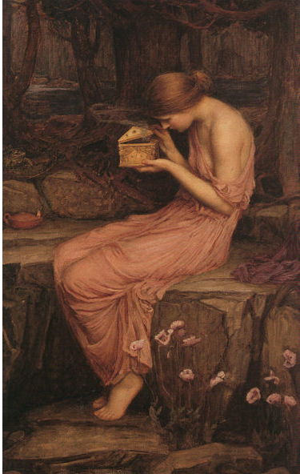
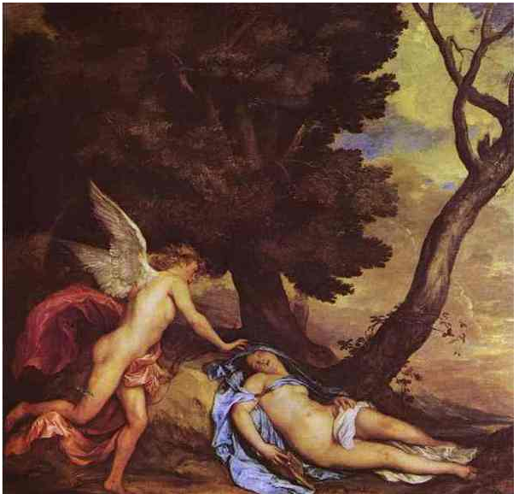

Slide 31
Cupid was healed of his woundaq by now and longing for Psyche ,and he found her at once.
Then waking her with just a prick from one of his arrows, and scolding her a little for her curiosity, he bade her take Proserpine's box to his mother and he assured her that all thereafter would be well.

Slide 32
Cupid wanted to make certain that V would give them no more trouble, so he went straight to Jupiter himself.
The Father of Gods and Men consented at once to all that Cupid asked.

Slide 33
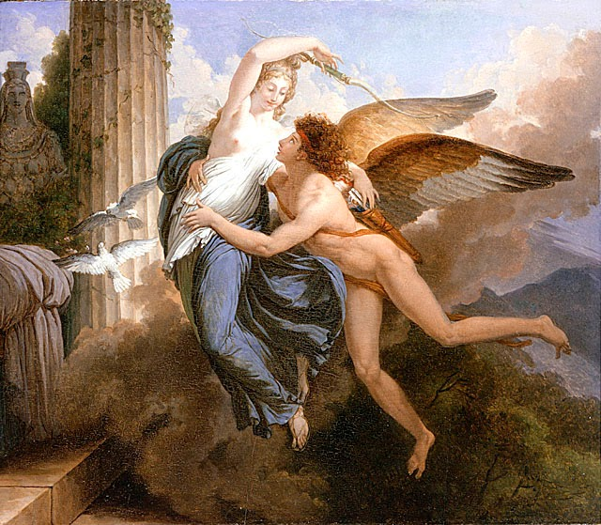
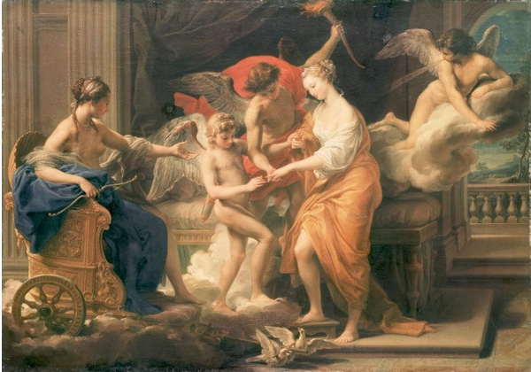
Then he called a full assembly of the gods,and announced to all, including Venus ,that Cupid and Psyche were formally married, and that he proposed to bestow immortality upon the birde.
So all came to a most happy end. Love and the Soul had sought and, after sore trials, found each other ; and that union could never be broken.

